Slide 1

Introduction to Databases

Slide 2
General Concepts
Database definition
  Organized collection of logically related data.
Data
  Known facts
  Types: text, graphics, images, sound, videos
  To access information from a database, you need a database management system (DBMS).
Database management system (DBMS)
  Software package for defining and managing a database
  This is a collection of programs that enables you to enter, organize, and select data in a database.

Slide 3
Database management systems (DBMSs)
Specially designed software applications that interact with the user, other applications, and the database itself to capture and analyze data.
A general-purpose DBMS is a software system designed to allow the definition, creation, querying, update, and administration of databases.

Slide 4
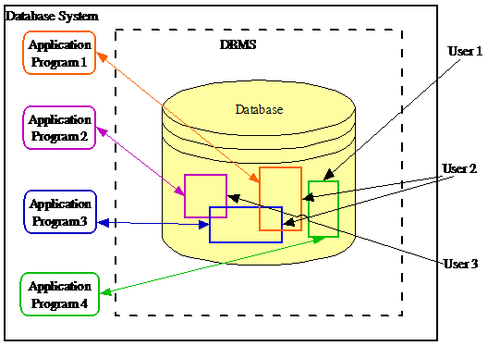

Slide 5
The interactions catered for by most existing DBMSs fall into four main groups:
Data definition – Defining new data structures for a database, removing data structures from the database, modifying the structure of existing data.
Update – Inserting, modifying, and deleting data.

Slide 6
Retrieval – Obtaining information either for end-user queries and reports or for processing by applications.
Administration – Registering and monitoring users, enforcing data security, monitoring performance, maintaining data integrity, dealing with concurrency control, and recovering information if the system fails.

Slide 7
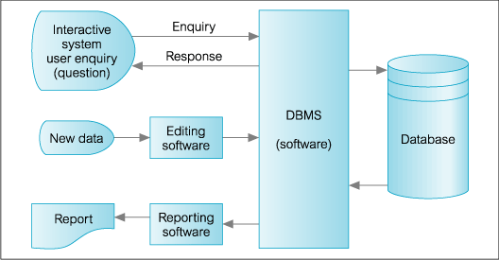

Slide 8
Well-known DBMSs
MySQL,
Oracle,
PostgreSQL,
Microsoft SQL Server,
SAP HANA,
dBASE,
FoxPro,
Microsoft Access

Slide 9
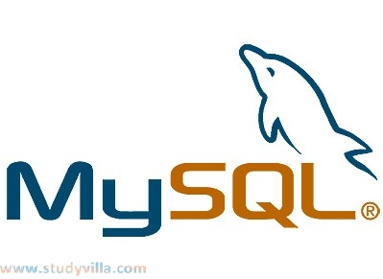
MySQL
The world's second most widely used open-source relational database management system (RDBMS).
Developer | Oracle Corporation
Initial release | 1995
Development status | Active
Written in | C, C++
Operating system | Windows, Linux

Slide 10
Oracle Database
Oracle is an object-relational database management system.
Developer(s) | Oracle Corporation
Initial release | 1977
Written in | Assembly language, C,C++
Type | ORDBMS
Operating system | Windows, Linux
Latest version | Oracle Database 12c Release 1: 12.1.0.2

Slide 11
Microsoft SQL Server
Microsoft SQL Server is a relational database management system developed by Microsoft.
Developer(s) | Microsoft
Stable release | SQL Server 2014 / April 2014
Written in | C, C++
Operating system | Microsoft Windows Windows Server

Slide 12
Database Examples
Class roster
Hospital patients
Literature (published articles in a certain field)
Genomic information
Protein structure
Taxonomy
Single nucleotide polymorphism

Slide 13
Database Models
Flat files ‘60
Hierarchical ‘60
Network ‘70
Relational ‘80
Object oriented ‘90
Object relational ‘90
Web enabled ‘90

Slide 14
Database Types (cont.)
Type | Typical number of users | Typical architecture | Typical size
Personal | 1 | Desktop/Laptop/ PDA | MB
Workgroup | 5-25 | Client/server:2 tier | MB-GB
Department | 25-100 | Client/server:3 tier | GB
Enterprise | >100 | Client/server: distributed | GB-TB
Internet | >1000 | Web sever & application servers | MB-GB

Slide 15
Flat Files
Characteristics:
Data is stored as records in regular files
Records usually have a simple structure and fixed number of fields
For fast access may support indexing of fields in the records
No mechanisms for relating data between files
One needs special programs in order to access and manipulate the data

Slide 16
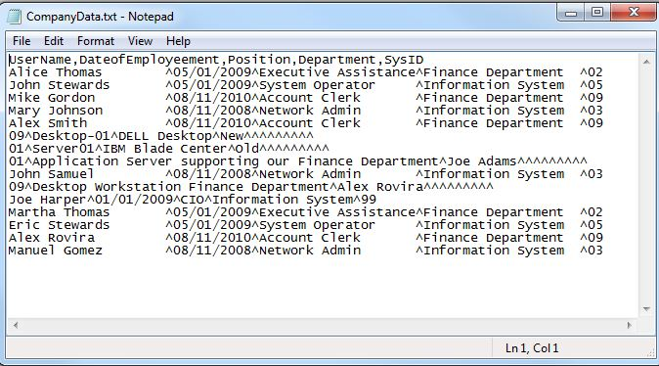
Example of Flat file

Slide 17
Relational Database
Characteristics:
Data is organized into tables: rows & columns
Each row represents an instance of an entity
Each column represents an attribute of an entity
Metadata describes each table column
Relationships between entities are represented by values stored in the columns of the corresponding tables (keys)
Accessible through Standard Query Language (SQL)

Slide 18
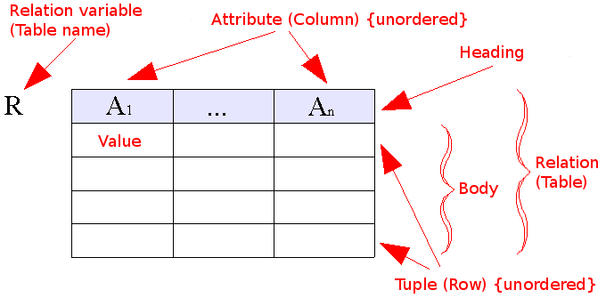
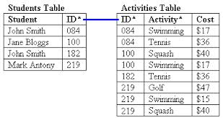

Slide 19
Enterprise data model
Graphical representation of the high level entities
Example: Microbial database
  each organism has multiple corresponding genes
  One:Many relation
Organism
1
m
Gene

Slide 20
Relationships
Used to connect tables
Field(s) that have the same value in the related tables
Organism.Accession=Gene.OAccession
Organism.Accession
  Unique
  Primary key
Gene.OAccession
  Not unique
  Secondary key

Slide 21
SQL
ANSI (American National Standards Institute) standard computer language for accessing and manipulating database systems.
SQL statements are used to retrieve and update data in a database.
Includes:
  Data Manipulation Language (DML)
  Data Definition Language (DDL)

Slide 22
Data Manipulation Language
Syntax for executing queries, updating, inserting, and deleting records.
SELECT - extracts data from one or more table
INSERT INTO - inserts new data into a table
UPDATE - updates data in a table
DELETE FROM - deletes data from a table

Slide 23
DML Example
Select all Escherichia coli K12 genes which are in the 1MB-2MB region of the chromosome:
SELECT *
FROM Organism, Gene
WHERE
Organism.Name=“Escherichia coli K12” AND Organism.Accession=Gene.OAccession AND Gene.Start>=1,000,000 AND
Gene.End<=2,000,000

Slide 24
DML Example (cont.)
INSERT INTO Gene
(Name, Accession, OAccession, Start, End, Strand, Sequence)
VALUES
(“thrL”, 16127995,”NC_000913”,190,255,’+’,”thr operon leader peptide”, “MKRI…”)
UPDATE Gene SET Start=160 WHERE Accession= ”NC_000913”
DELETE FROM Gene WHERE Accession= ”NC_000913”

Slide 25
Data Definition Language
Syntax for creating ,editing, deleting:
Databases
Tables
Views
Indexes
Constraints
Users
Privileges

Slide 26
DDL Examples
CREATE DATABASE Microbial;
CREATE TABLE Organism (
Name varchar(100)
Size int(10)
Gc decimal(5)
Accession varchar(10)
Release date(8)
Center varchar(100));
ALTER TABLE Organism ADD Sequence varchar;
DROP TABLE Organism;

Slide 27
DBMS
Software package for defining and managing a database.
Examples:
  Proprietary: MS Access, MS SQL Server, DB2, Oracle, Sybase
  Open source: MySql, PostgreSQL

Slide 28
DBMS Advantages
Program-data independence
Minimal data redundancy
Improved data consistency & quality
  Access control
  Transaction control
Improved accessibility & data sharing
Increased productivity of application development
Enforced standards

Slide 29
Web Databases
Data is accessible through Internet
Have different underlying database models
Example: biological databases
  Molecular data: NCBI , Swissprot , PDB , GO
  Protein interaction : DIP , BIND
  Organism specific: Mouse , Worm, Yeast
  Literature: Pubmed
  Disease

